Slide 1
AIVI: Artificial Intelligence for the Visually Impaired
Collin Heaney, Anil Dasrat, Yash Jajoria
April, 24, 2025

Slide 2
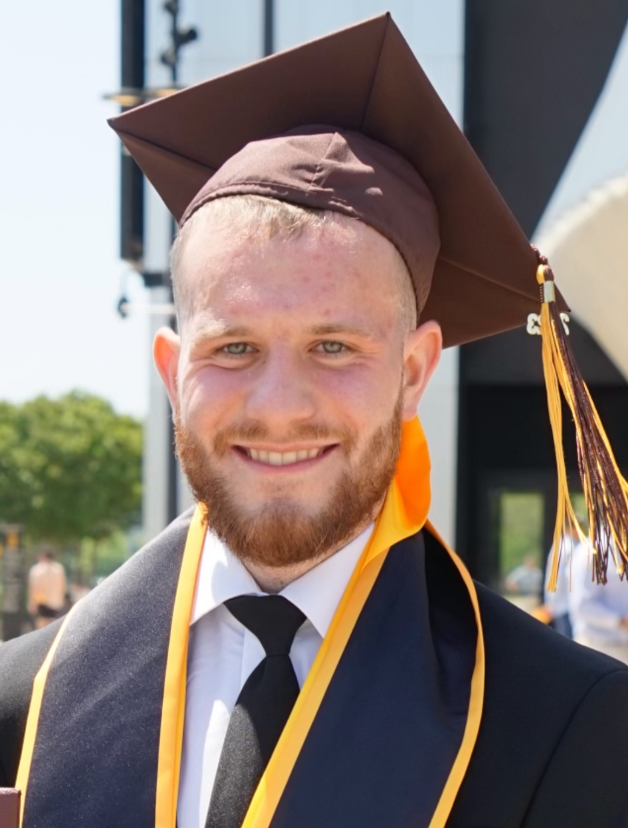

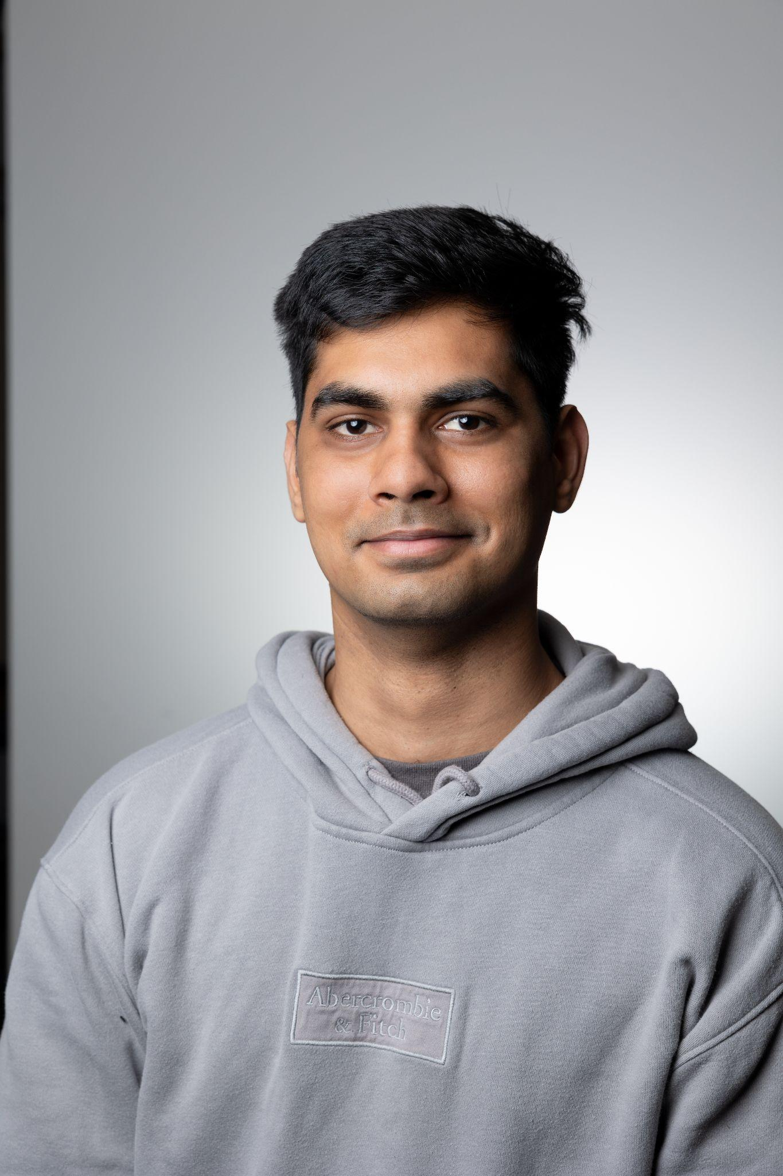
The Team
Collin Heaney
collinheaney@mail.adelphi.edu
AI Development and Implementation
Anil Dasrat
anildasrat@mail.adelphi.edu
Code Development and Hardware Implementation
Yash Jajoria
yashjajoria@mail.adelphi.edu Assisted with Total Development

Slide 3
Introduction
Accessibility is everything
Technologies like walking canes and service animals are used to aid those with visual impairments
Technology is powerful and ever increasing
Artificial Intelligence software is highly prevalent in everyday life with technologies such as ChatGPT and Google Gemini
Is there a way to combine accessibility and technology to help those with visual impairments?

Slide 4

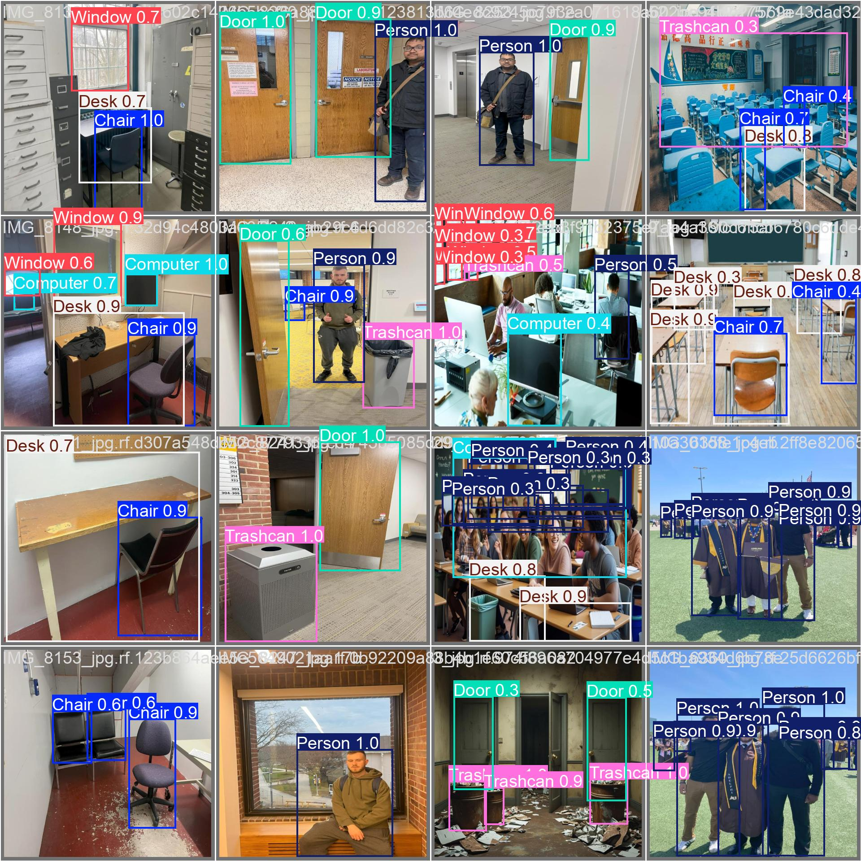
AIVI
AIVI uses a trained AI model connected via a camera to scan environments, identify objects, and audibly translate these objects to the user
AIVI fills a technological gap with visual impairment with a goal to help those with visual impairments
While there already exists technologies, AIVI by itself or paired with an existing technology will improve accessibility

Slide 5

AIVI Methodology
Physical Setup and Training

Slide 6
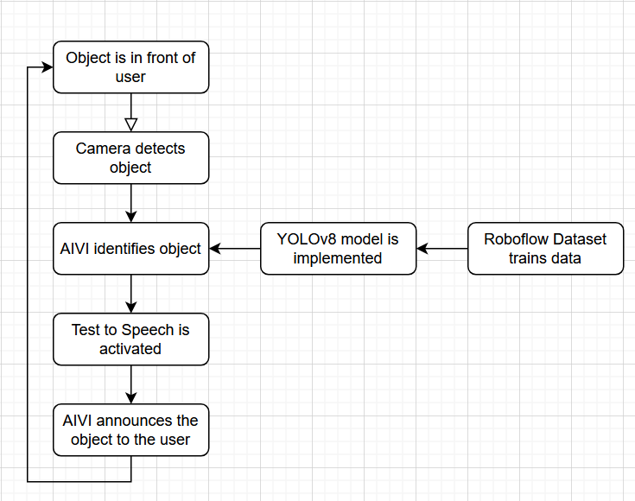
How Does it Work?
Code, Physical Setup, and Flowchart
AIVI is designed based on the YOLOv8 model created by Ultralytics
In the code, we determined 3 variables: the type of object, the relative distance the user is from the object, the direction the object is relative to the user
Once the variables are identified, a text to speech voice will announce to the user this information
A raspberry pi is used to hold the code. While connected to a battery pack to supply power, the raspberry pi is connected to a Logitech USB camera

Slide 7
Introducing Roboflow
AI models do not learn by themselves, they must be taught
Roboflow: object detection training software for Ultralytics
Images are uploaded, annotated by class, divided into a train validate test split, and trained through Roboflow or Google Colab
Results come in three different scores:
mAP50: Mean Average Precision of each class with a .5 confidence threshold
Precision: Accuracy of classifying objects
Recall: Accuracy of identifying objects to be classified

Slide 8
Training AIVI
For AIVI:
4 total different versions
518 total images
7 different classes
70-15-15 train validate test split
Trained via Google Colab for YOLOv8
Class | Total
Chair | 931
Computer | 509
Desk | 766
Door | 396
Person | 468
Trashcan | 293
Window | 577

Slide 9
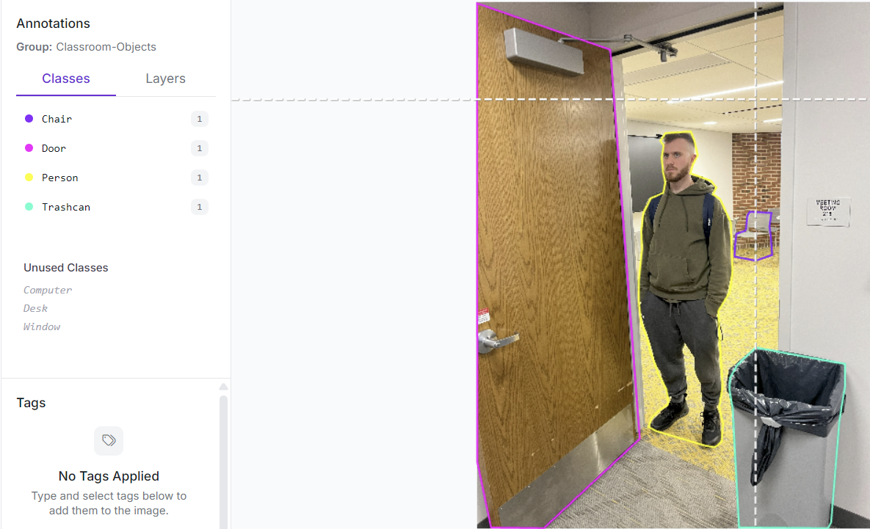

Slide 10
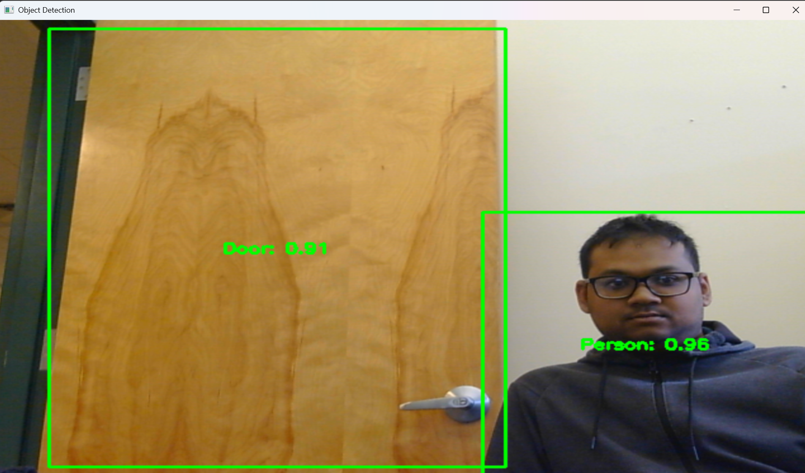
AIVI Results

Slide 11
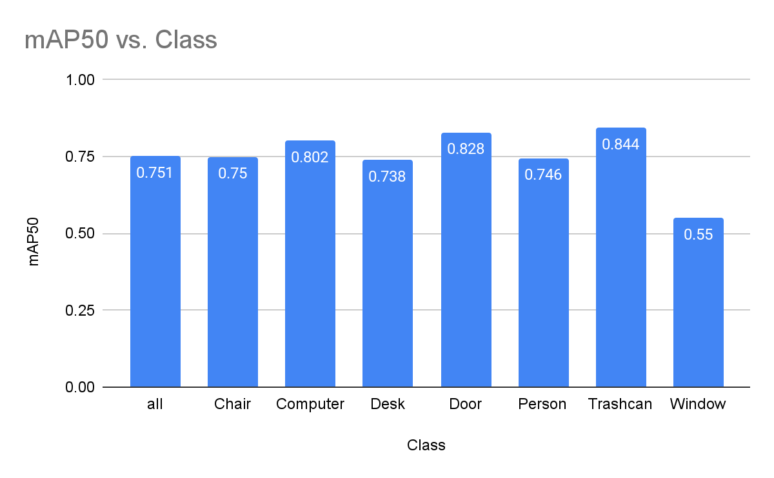
mAP Scores By Class

Slide 12
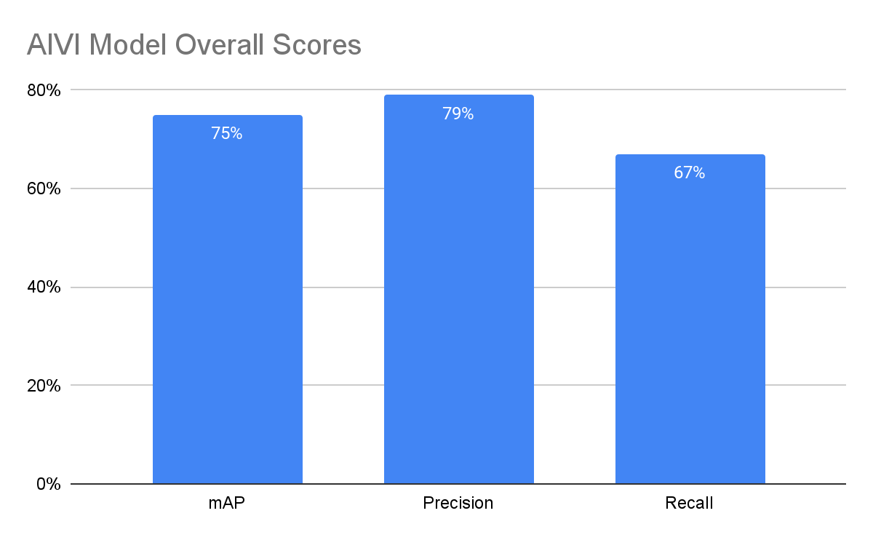
mAP, Precision, and Recall Scores

Slide 13
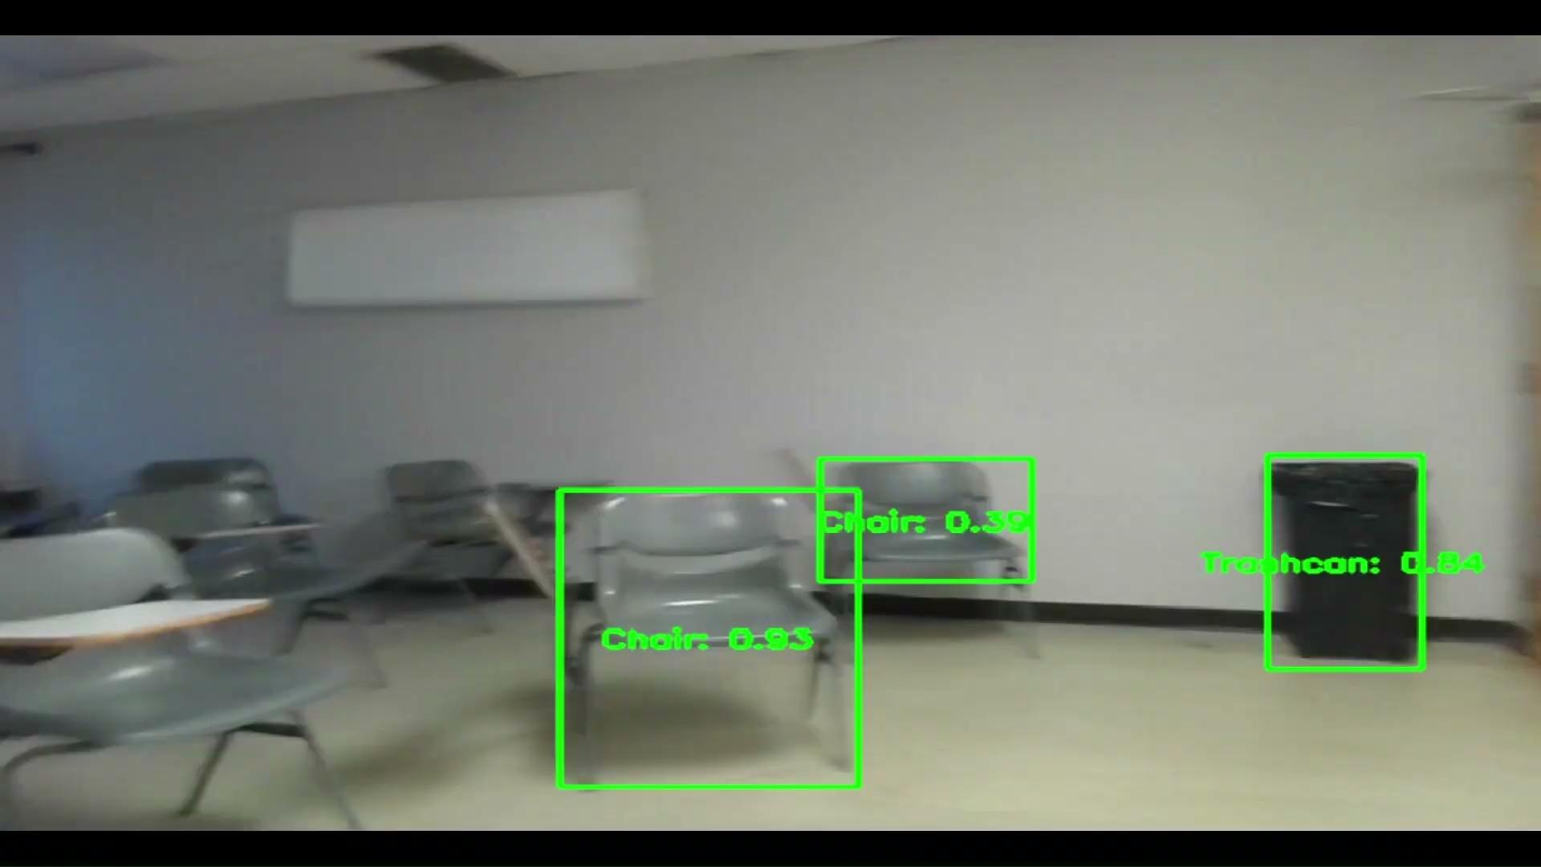
Video

Slide 14
If We Had More Time…
Add more data
The free version of Roboflow supports up to 10,000 images per project
Balance Classes
Make more classes of objects
Working in a smaller scope
Improve camera and speakers
Connect AIVI to Wi-FI
Run via app
Voice recognition technology
Turn on/off command
What is in front of me?

Slide 15
Conclusion
Combination of physical camera, trained AI model, and audible translation
Identify object, classify object, give relative distance, give relative direction
Yolov8 Framework, Roboflow Model, Raspberry Pi
Set to improve accessibility for visual impairment
Improve visual impairment technology
With or Without the aid of other visual impairment tools
75% mAP is a great start
More data would only improve

Slide 16
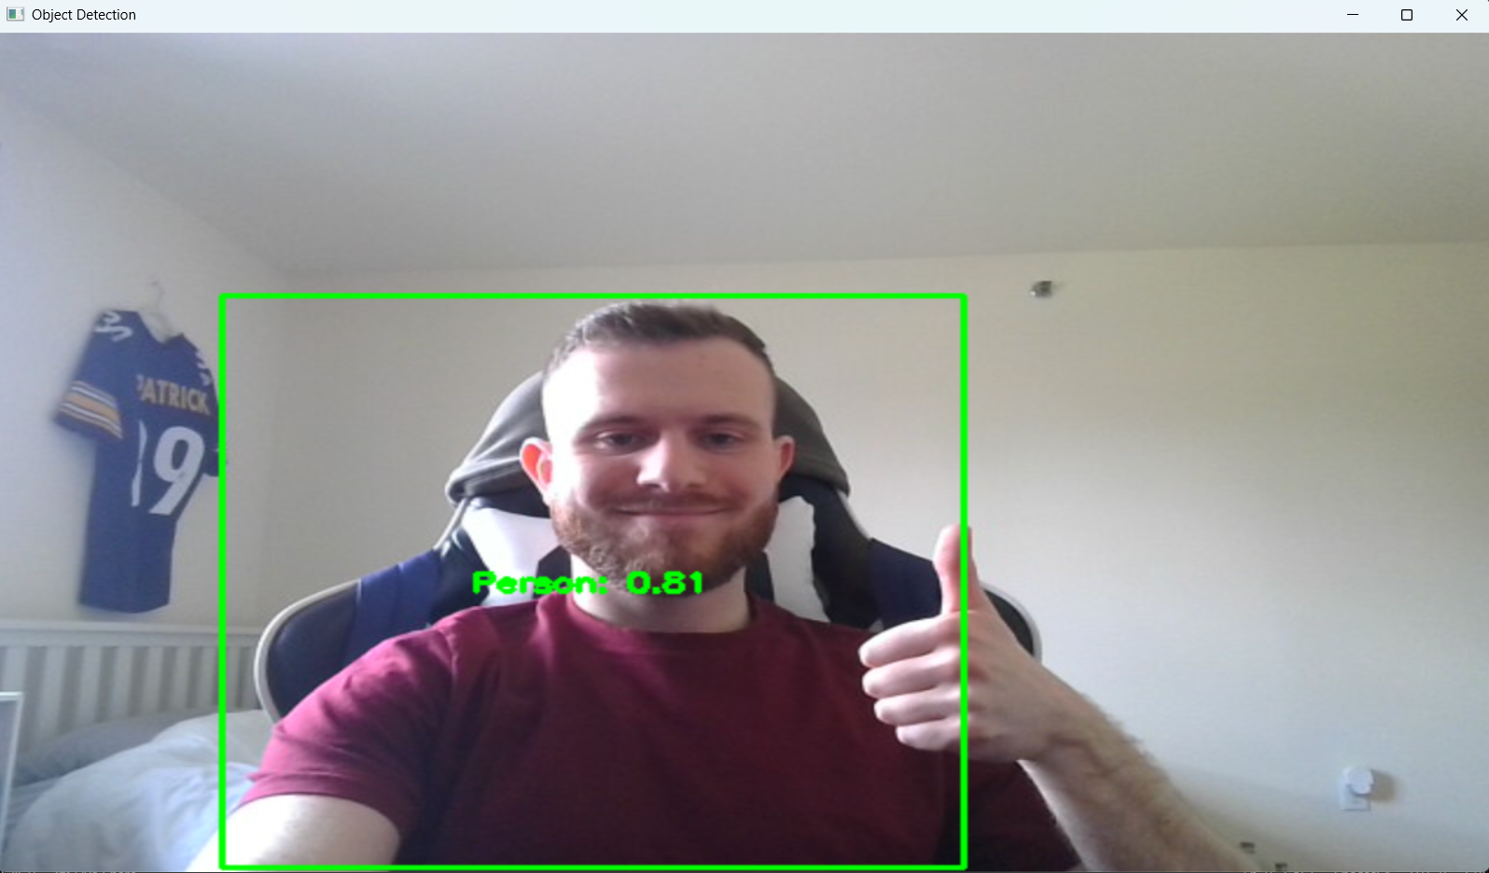
Thank You! Any Questions

